Slide 1

Data Wrangling and Visualization Project in Tableau

Slide 2
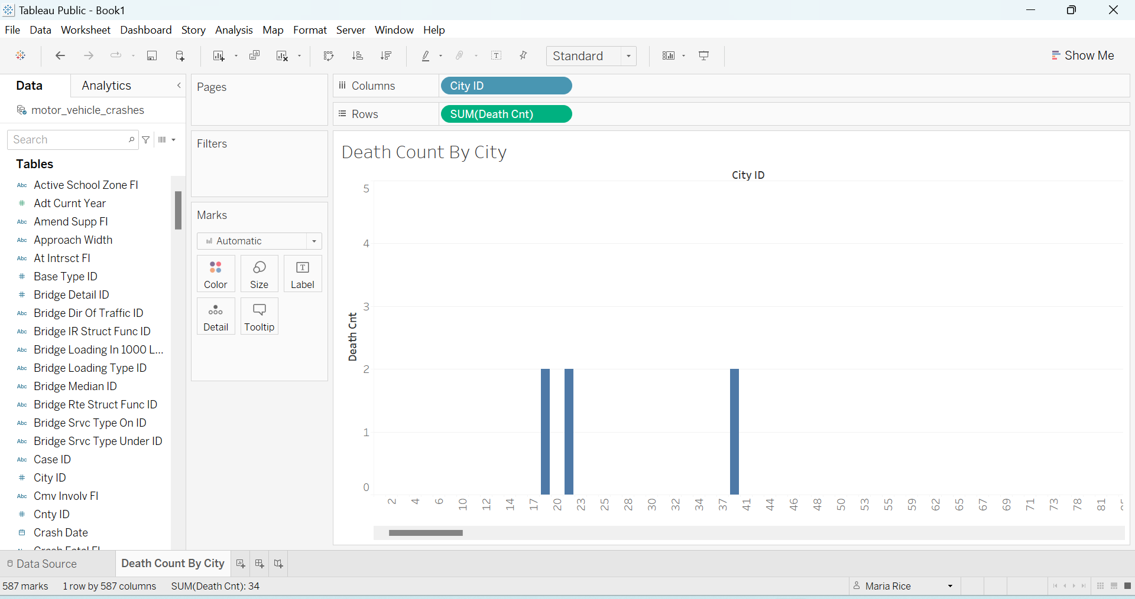
Here we have a death count by “City ID”. As it shows, some cities have many deaths while others have absolutely none. I would be curious to know whether there are more drugs and drinking in those specific cities because that can be one of the factors of motor vehicle deaths and injuries. I did not see drugs or alcohol in this data set to be able to compare (unless I missed it, or it’s renamed something else).

Slide 3
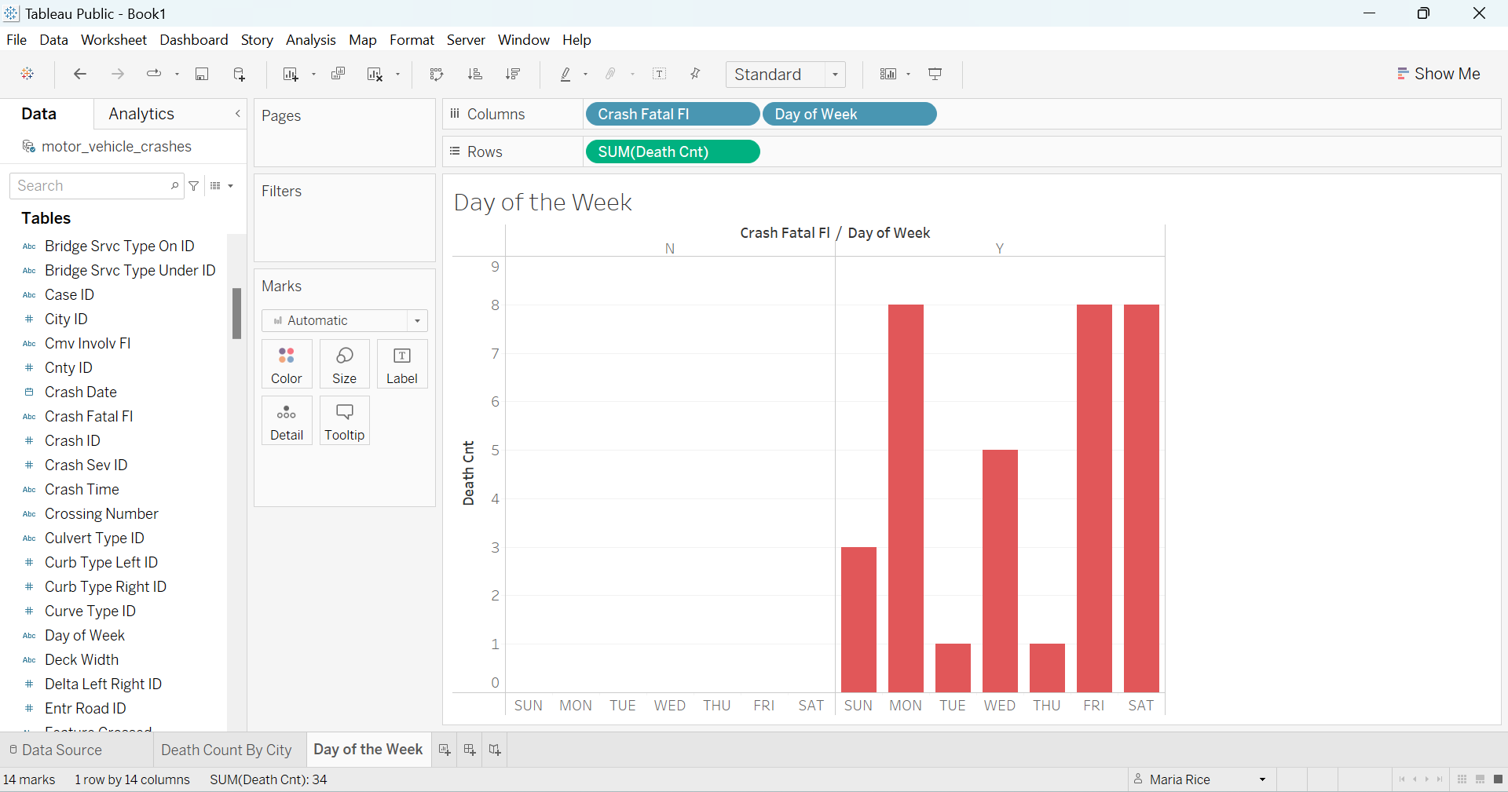
Here you will see Death Count, Crash Fatal FL and Day of Week. Tuesday and Thursday are the lowest for Fatal Crashes during the seven days. Sunday is higher and Wednesday has crept up above that. Friday, Saturday and Monday hold the greatest number of fatal crashes. Could this be due to traveling more on the weekends? But what about Sunday? Maybe a lot of people drive home on Mondays? Does this have anything to do with drinking parties? There could be many factors here.

Slide 4
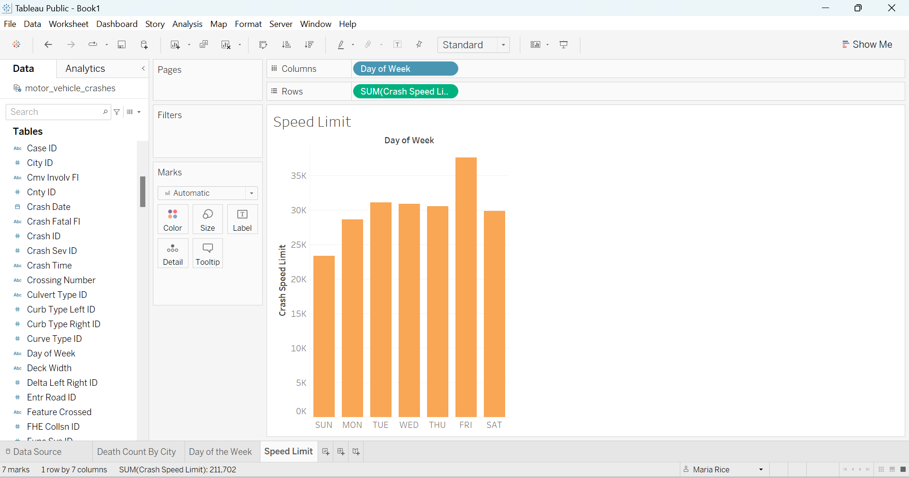
Crash Speed Limit and Day of Week shows a significant amount of crashes total. I did not insert Death or any type of Injury in this one but typically one or the other is likely to happen. Friday has the highest amount of speed limit crashes while Sunday has the least. Looking at the set there is a large amount all around for Crash Speed Limit. Is speed the reason for so many crashes? Maybe (again) it’s a combination of many different factors that are obviously not shown that go along with speed.

Slide 5
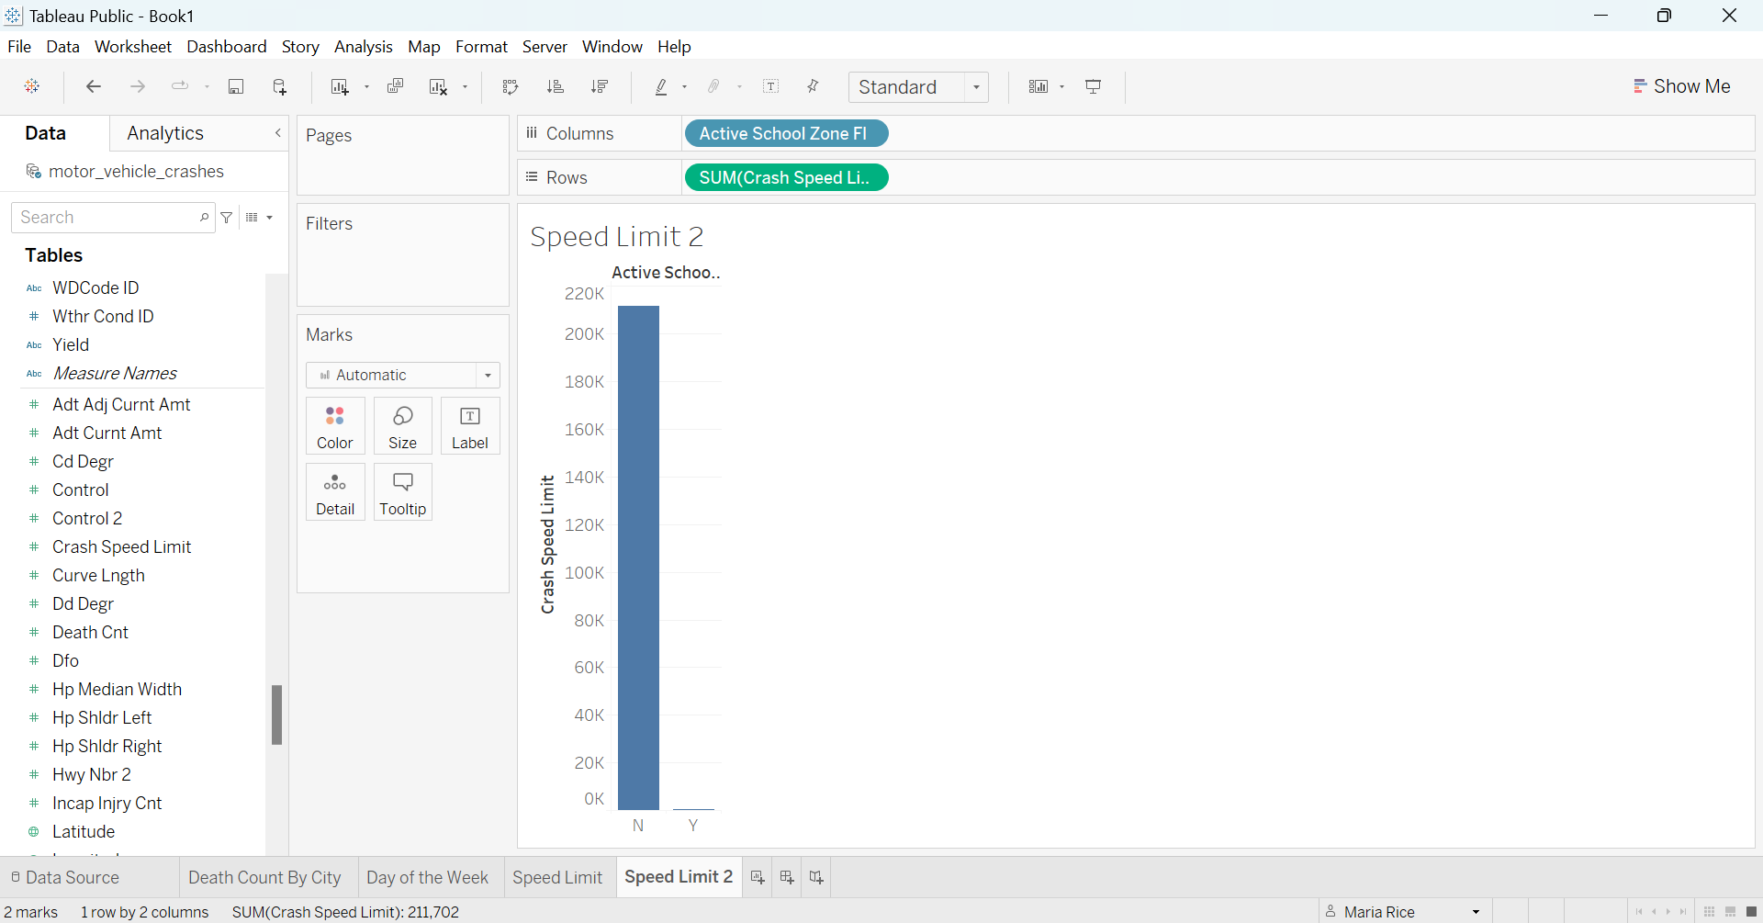
We can see in this graph that Crash Speed Limit is low in the Active School Zone FI. I am assuming the N means No and the Y means yes on the X Axis. For the most part you don’t hear of that many crash speed accidents in a school zone. This is most likely due to there being much lower speed limits set for school zones in the first place.

Slide 6
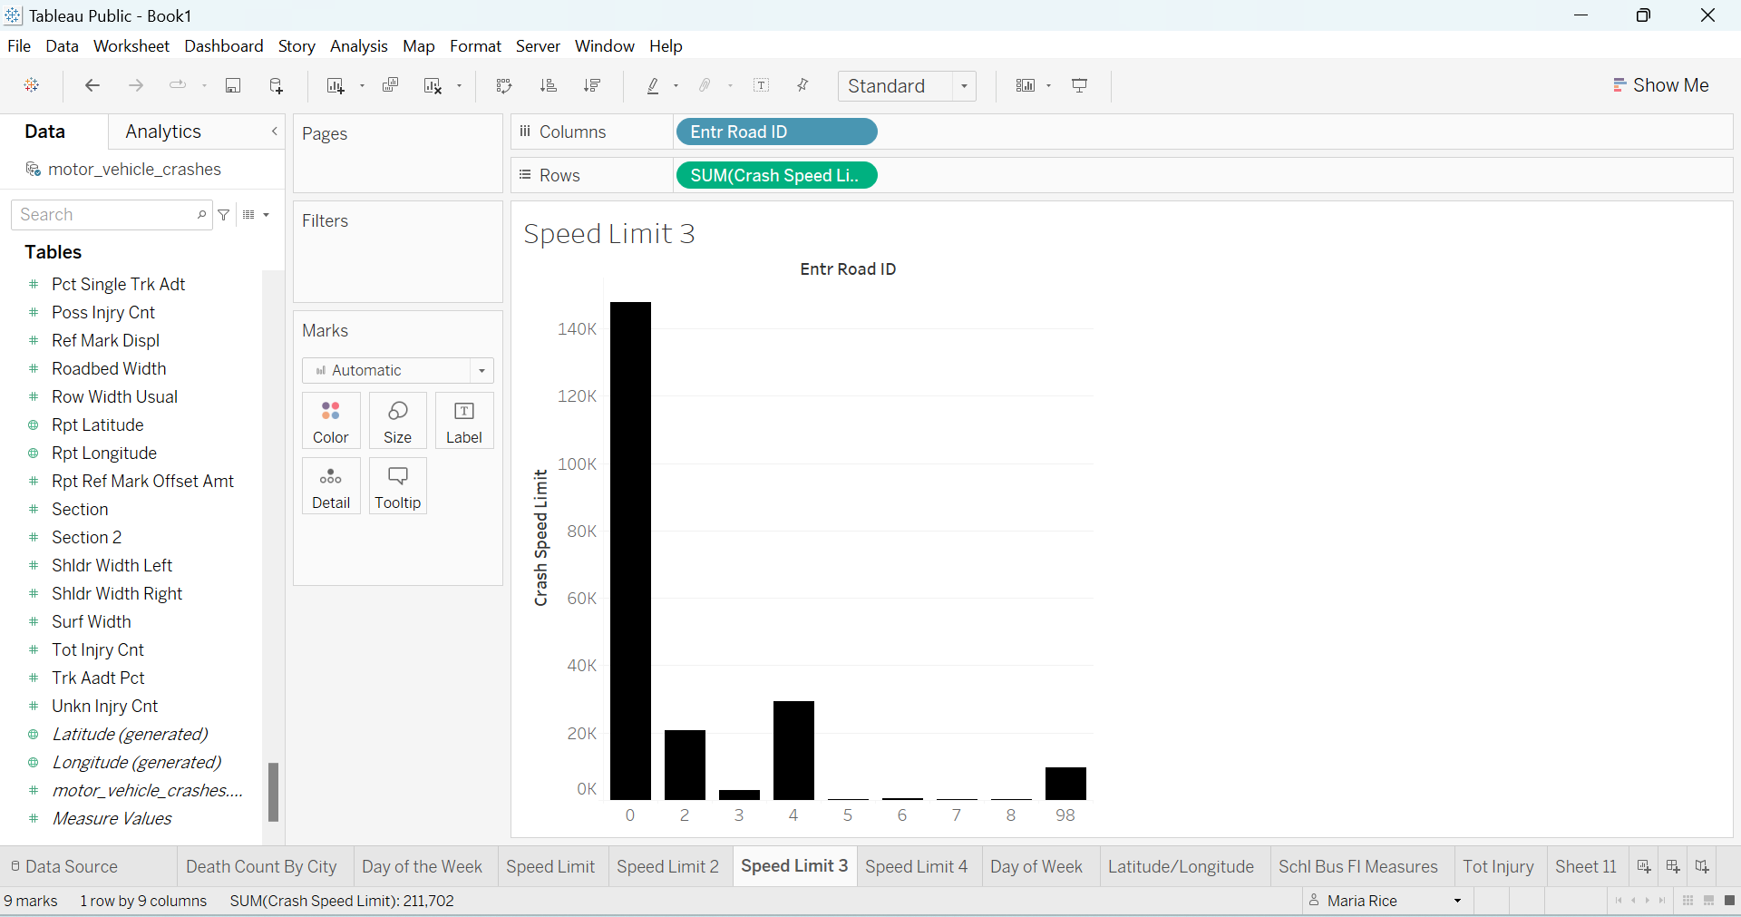
I tried my hand at using some of the ID data but didn’t find it helped much which makes me want to draw conclusion of what it might mean. I also used google to try to make light of it. It could mean the ID of the road it happened on in the accident report. It also came up as apparel but this is about vehicles so it would not be that.

Slide 7
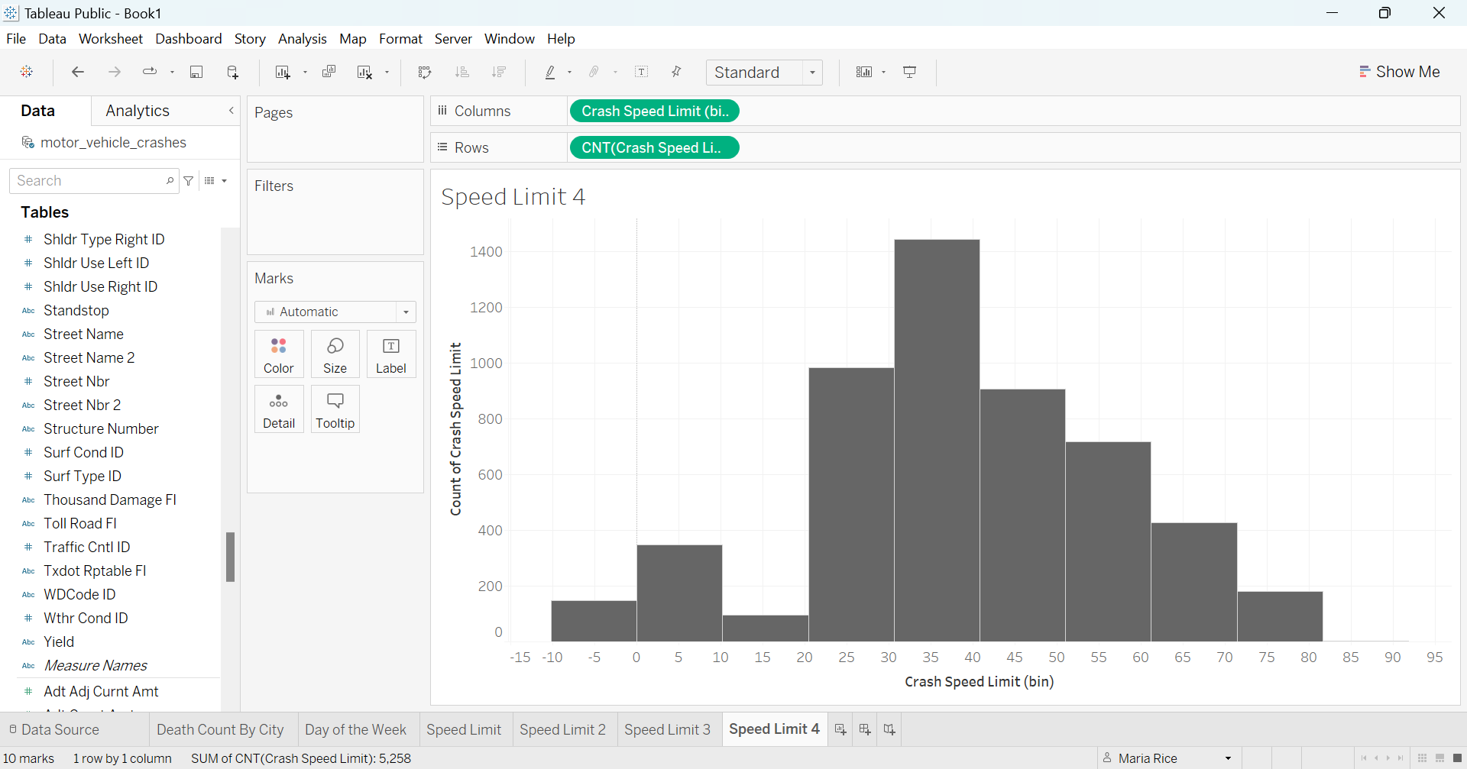
If I’m reading this graph right more crashes happen when the speed limit is 25-50. That was not what I was expecting. The most crashes happened at the speed of 35-40. I will say I’ve actually heard that some of the worst crashes have happened at lower speeds. Maybe it’s possible in bigger cities where speeds are lower the crashes are greater because there is more traffic. This graph does not specify where the crashes are located so that may or may not be a factor. It’s possible If I had added in “City ID” it would have given more information about it.

Slide 8
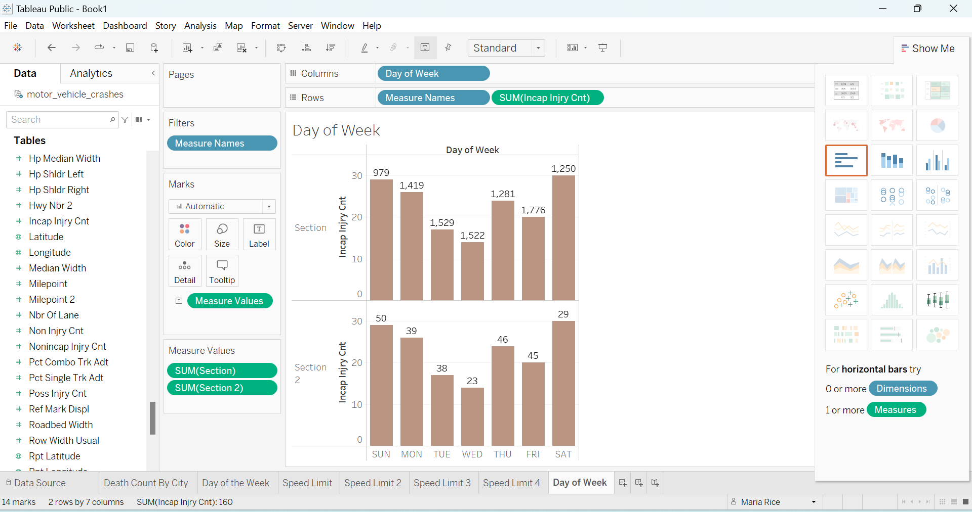
There are two different sections with injury counts. The top one has significantly larger numbers than the bottom one, but the days of the week appear to be similar when looking at the bars. I don’t know much else about this but am curious what the sections are about.

Slide 9
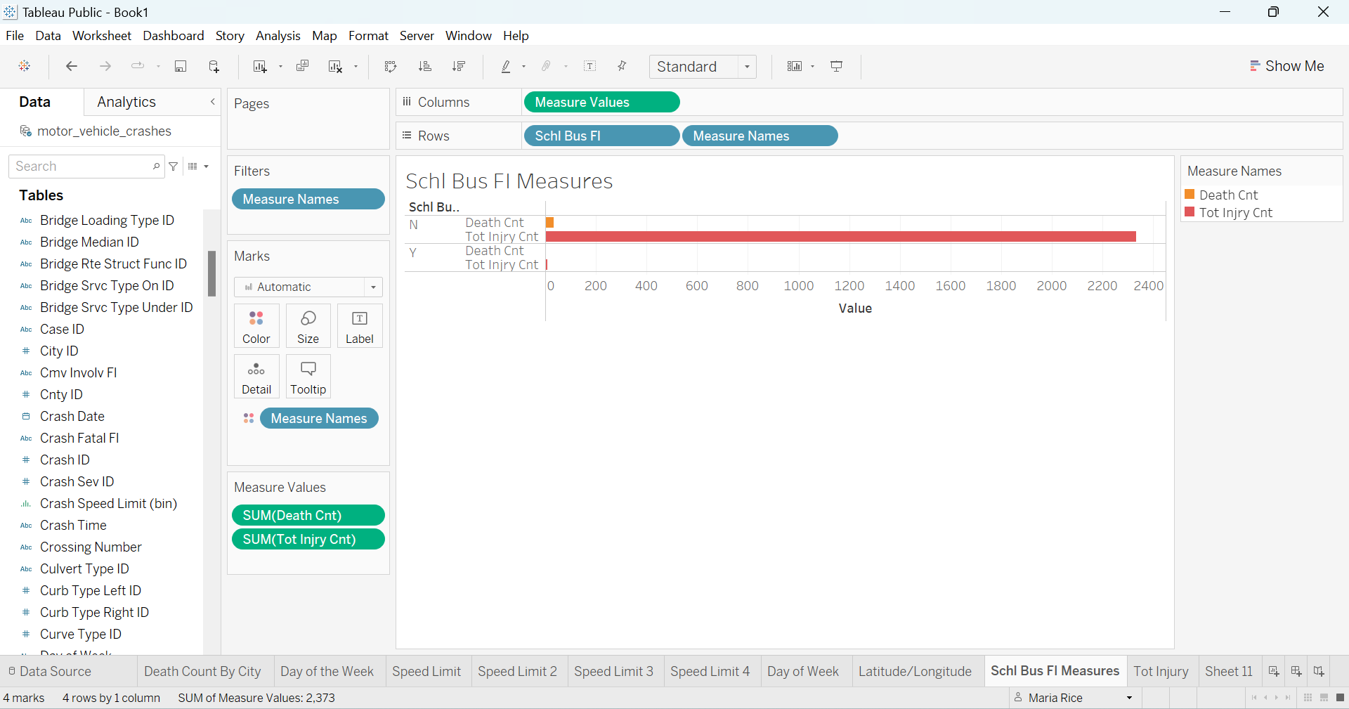
I am still trying to figure out what Y and N stand for. In the “N” section there are a few deaths, but injuries are very high – almost 2400. In the “Y” section there are no deaths but a couple of injuries.

Slide 10
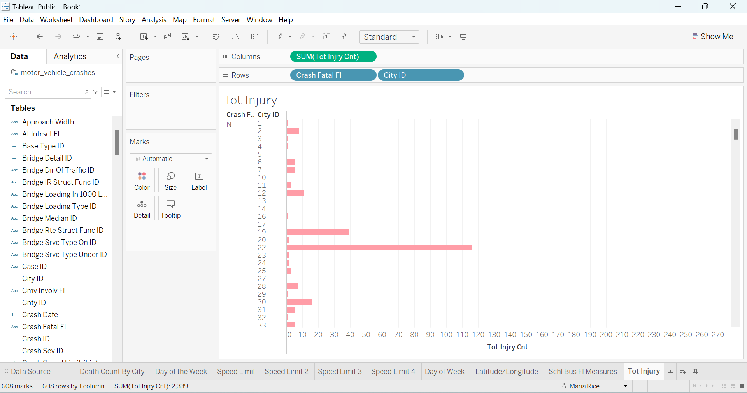
In the below graph you will notice in some Cities the crash fatal for tots is much higher than others. There has to be an underlying issue whether it’s just bad driving or failure to have the child in a car seat properly or at all according to age limit and weight. I could have also entered speed in here and it may have said a lot about that too.

Slide 11
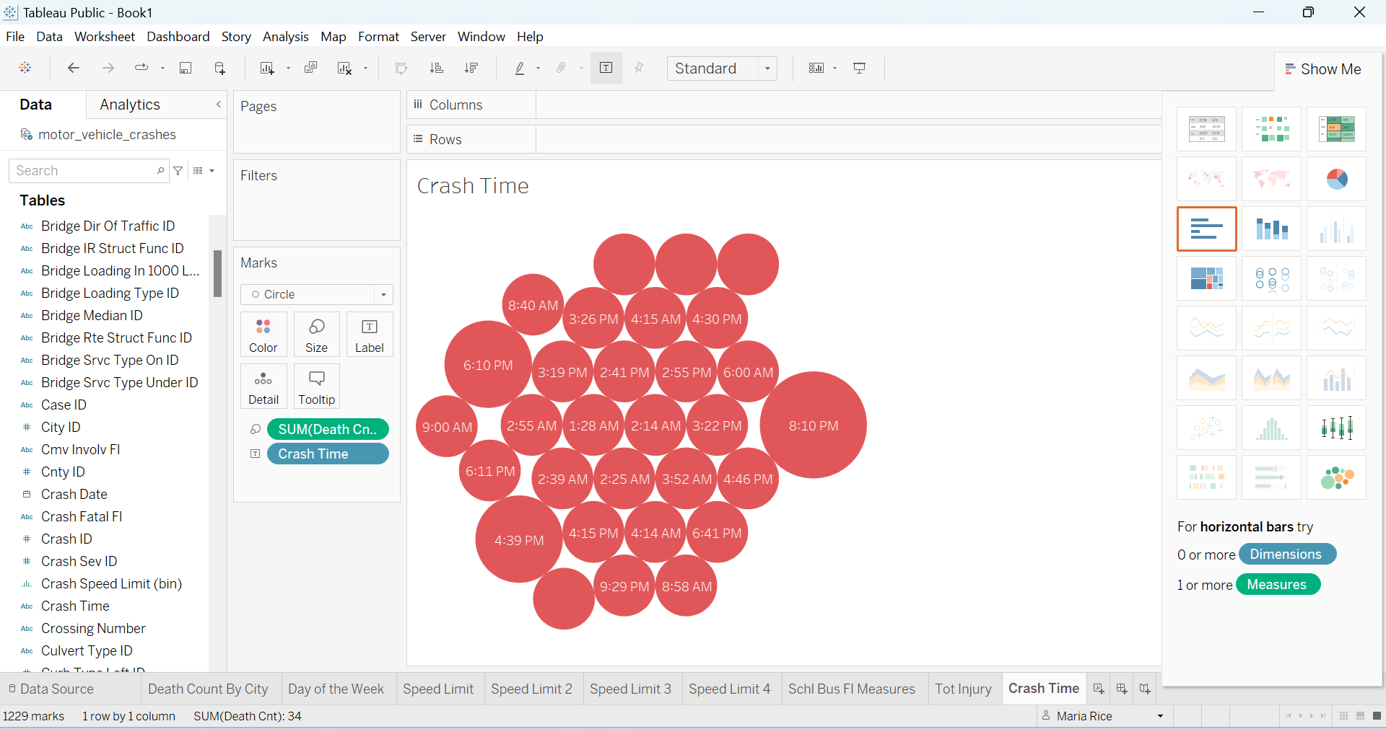
Here I did a bubble graph of the Crash Time and Death Count. You can’t tell here but when hovering my mouse over the different times some say 2, 3, or 1. That is the number of deaths during that time frame. The bigger the bubble the more death counts. Between 4:30PM and 8:10PM is displaying when the number is the highest for vehicle crashes.

